Slide 1
Version Control Practical Introduction
Git GUI and GitHub
Benjamin Kenwright

Slide 2
Overview
What is version control and why do we use it?
Different types of version control (e.g., SVN & GIT)
GitHub (secure and unlimited public code repository)
Registering with GitHub
Installing git client (i.e., git gui)
Creating a repository, adding a file, and committing it locally and to the main repository
Summary

Slide 3
What is Version Control?

Slide 4
Version Control
Industry requirement (i.e., you’re expected to know)
Secure safe storage (e.g., compared to USB)
Cross platform (e.g., PC, Mac, and Linux)
Track code changes
Issue/bug tracking
Multiple users/share
Branch builds (e.g., release/debug)
Alerts (e.g., when someone changes assets)

Slide 5
Installing GIT (If you don’t already have it installed)
Windows: git-scm.com/download/win
Mac: git-scm.com/mac
Linux: sudo -apt-get install git (Ubuntu)
or sudo yum install git (Fedora)
Once installed check the Git version in the command prompt, type: git --version

Slide 6
First Time GIT Setup
Set Your Identity
Command prompt type:
git config --global user.name “Homer Simpson”
git config --global user.email “homer@simpsons.com”

Slide 7
GIT Workflow (Three States)
A GIT repository file can reside in three main states
1. Modified
2. Staged
3. Committed
What does this mean?

Slide 8
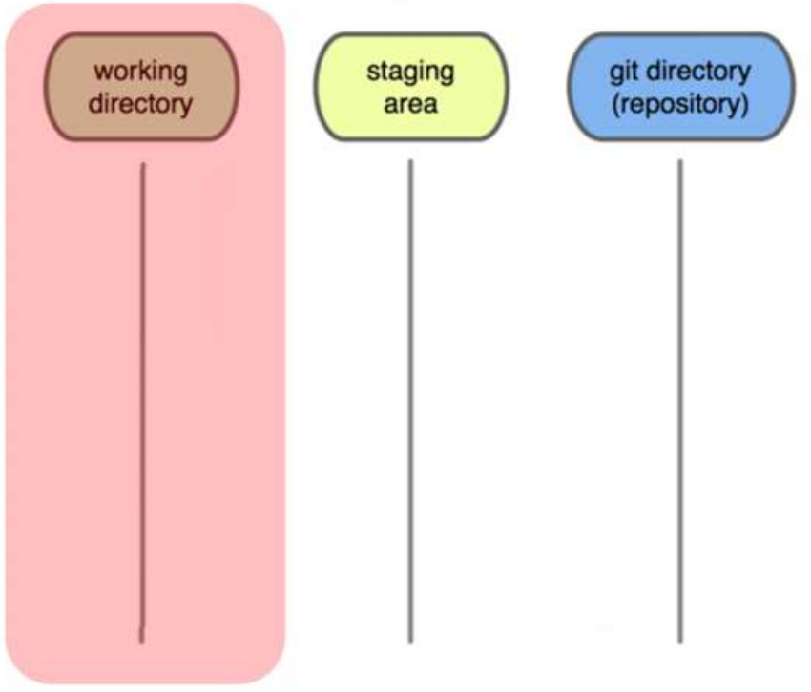
GIT Workflow (Three States)
Local Operations
You modify files in your working directory

Slide 9
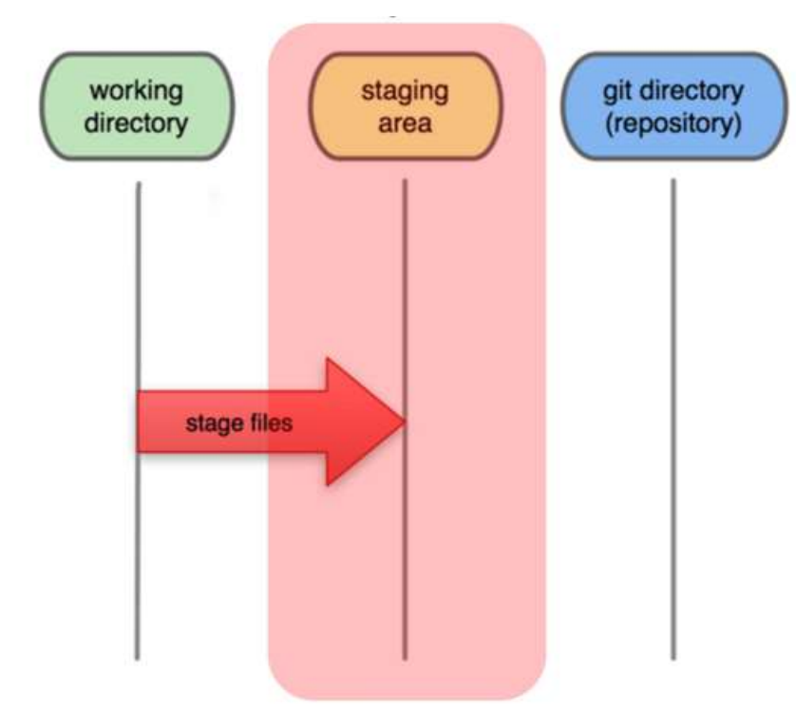
GIT Workflow (Three States)
Local Operations
You stage the files, adding snapshot of them to your staging area

Slide 10
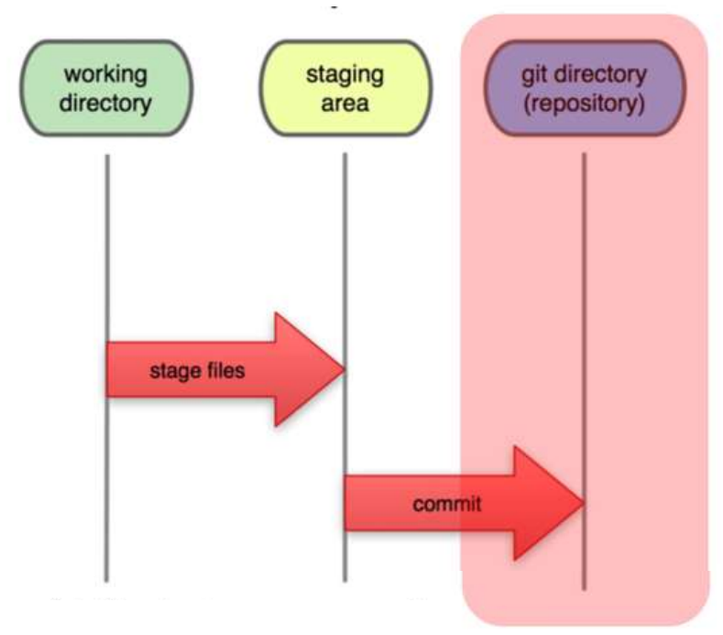
GIT Workflow (Three States)
Local Operations
You commit the stored snapshot permanently to your Git directory

Slide 11
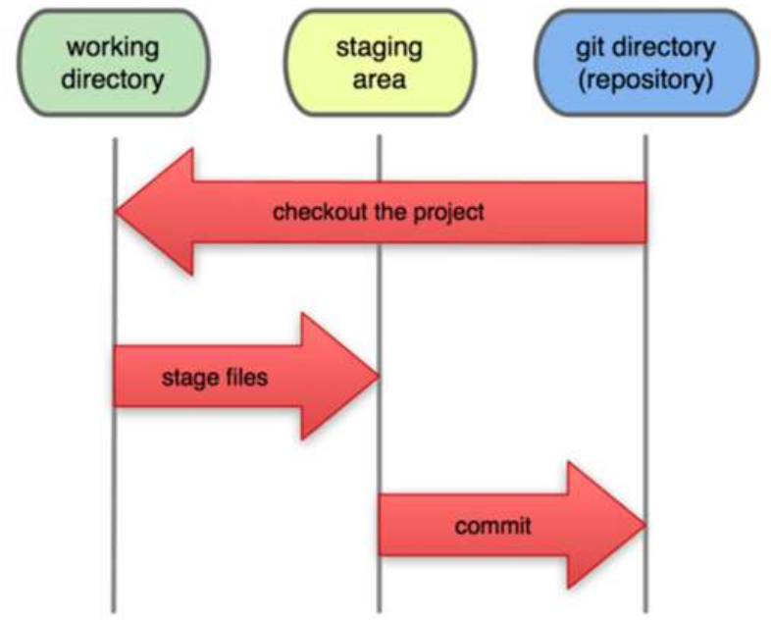
GIT Workflow (Three States)
Local Operations
Then you can checkout any existing version, make changes, stage them and commit

Slide 12
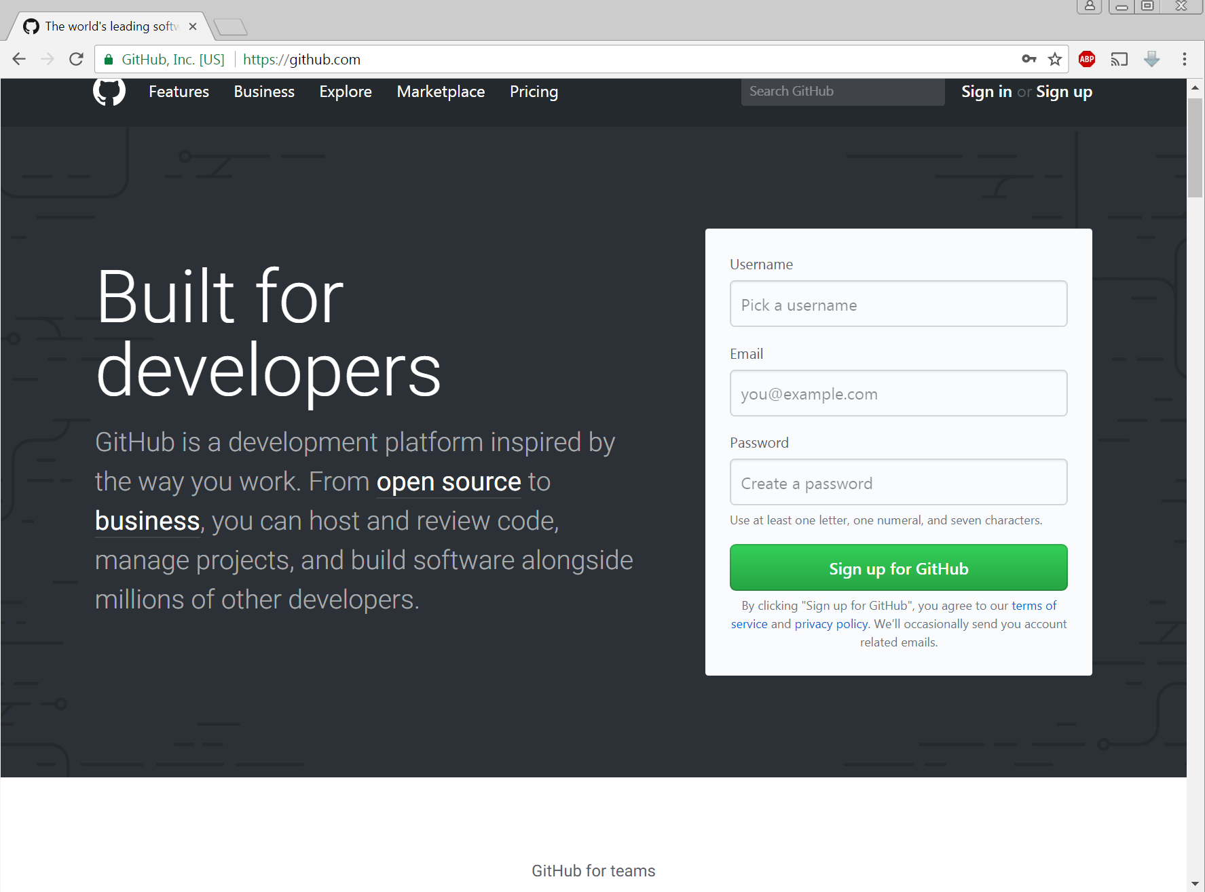
Why GitHub?
GitHub (https://github.com/)
Other version control hosts
BitBucket (https://bitbucket.org/)

Slide 13
Getting Started with GitHub
GitHub (https://github.com/)
Register (username and email)
Create repository
Manage repository using a local git-client

Slide 14
Getting Started with GitHub
Installing & registering

Slide 15
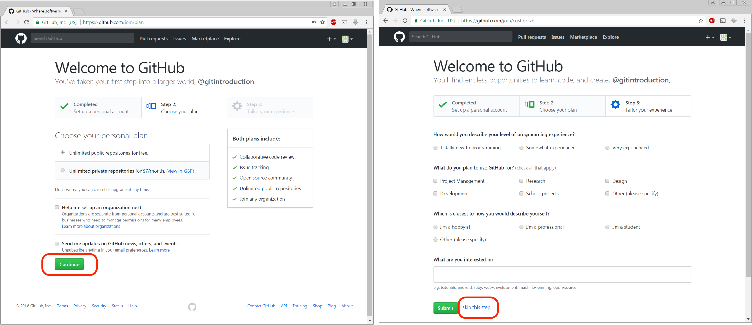

Slide 16
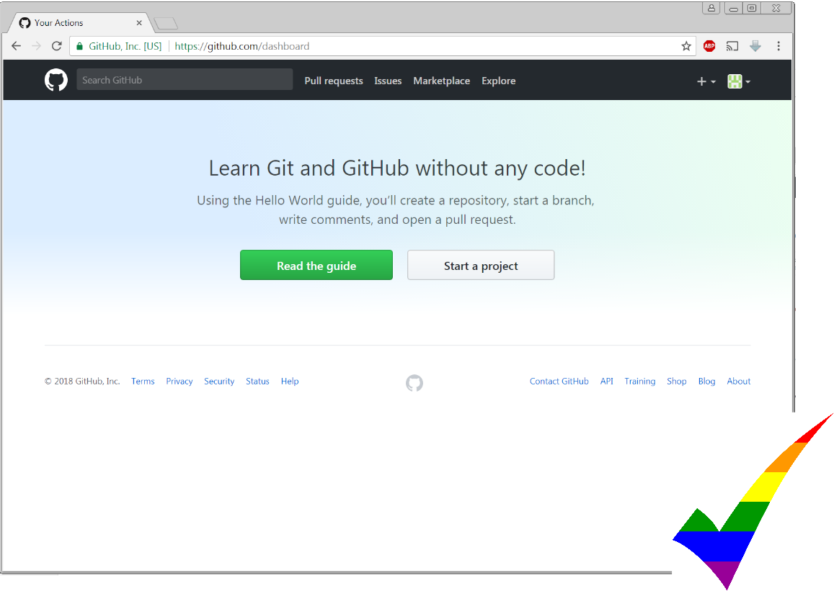

Slide 17
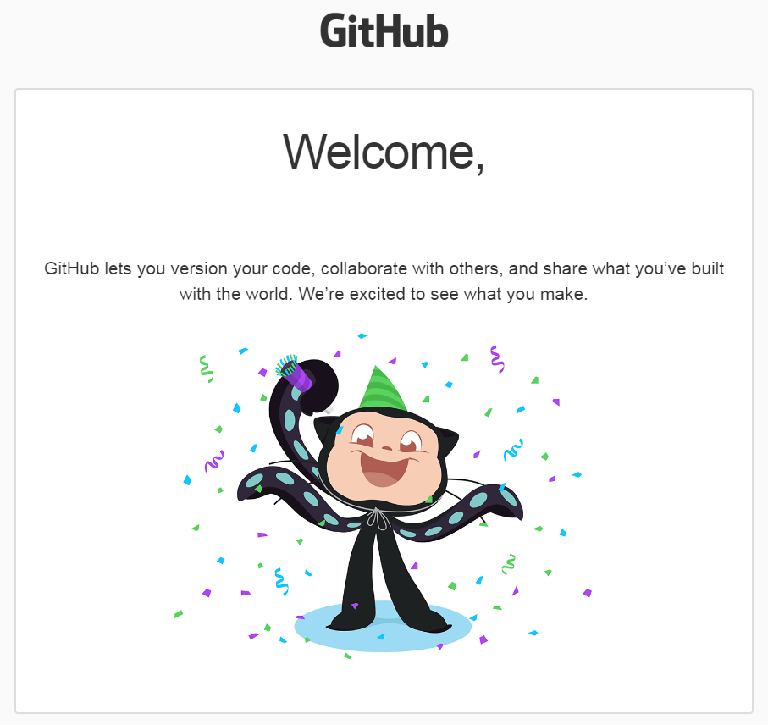
Verify GitHub Account
Verify by Email before you Continue
Can’t Create Repositories Until Verify Email

Slide 18
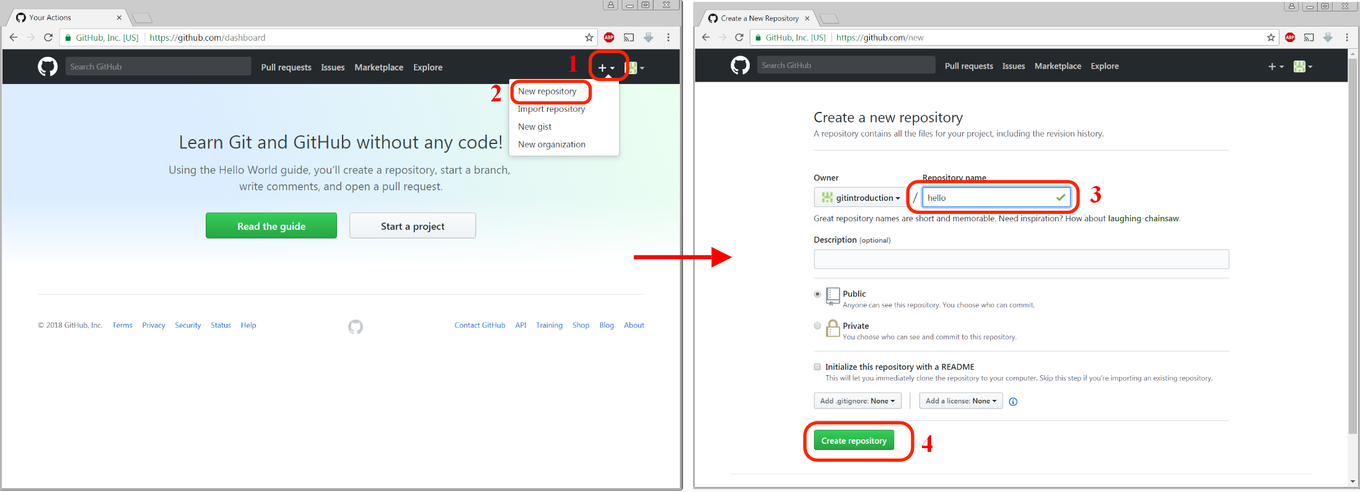
Create Repository
Repository Name (e.g., ‘Hello’)
Multiple Repositories

Slide 19
Copy Address

Slide 20
Create Local Repository (Folder)
1. Create Empty Folder
(e.g., Hello)
2. Navigate to it in the command prompt
and sync it to GitHub Repository
3. Type:
git init
git remote add origin https://github.com/username/hello.git

Slide 21
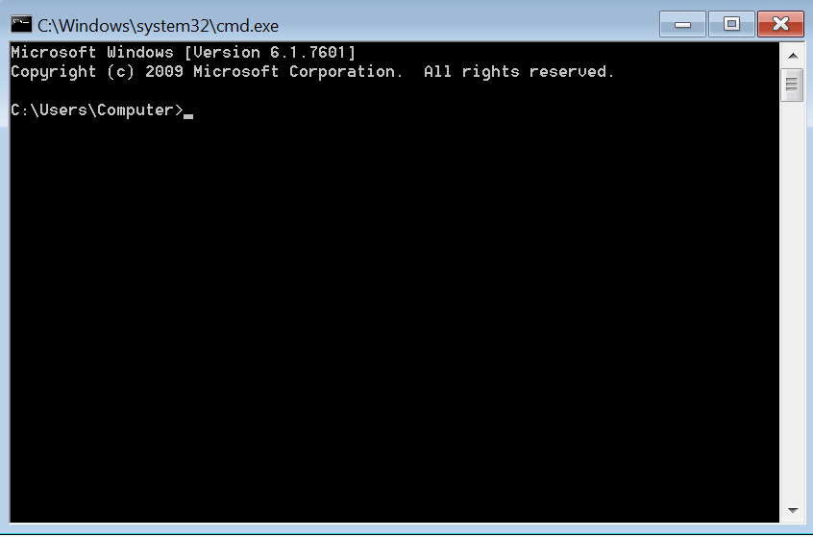
Command Prompt
So you think the command prompt is scary?
There are tools for that
Use the simple ‘Git GUI’

Slide 22
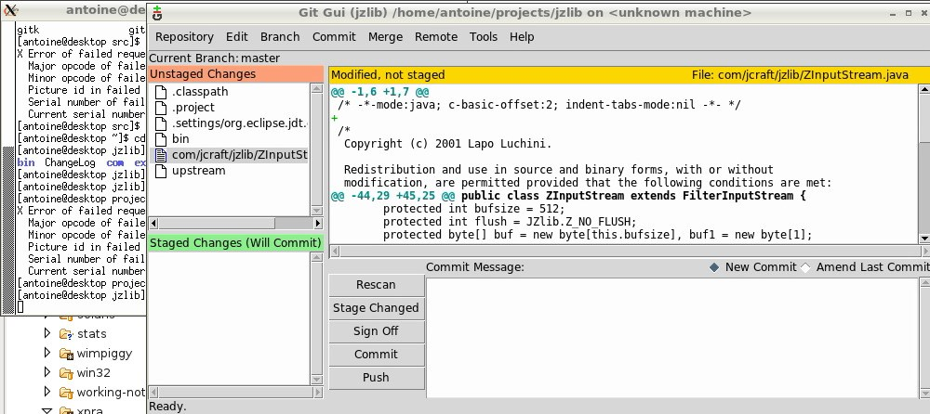
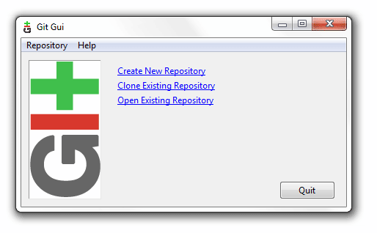
Local Client
Git GUI
Type ‘git gui’ Command Prompt
Other GUI Clients (https://git-scm.com/download/gui/windows)

Slide 23
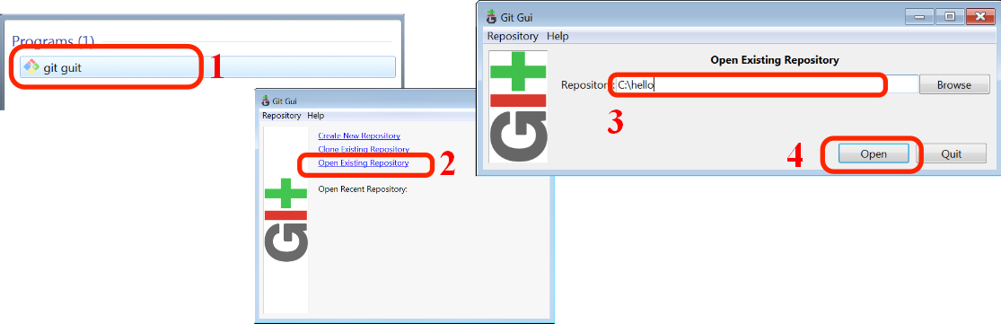
Local Client
Local Client Manager
i.e., to pull/push modifications into our repository
Command Prompt Type ‘Git GUI’

Slide 24
Connected
Folder & Repository
Synchronized (Linked)

Slide 25
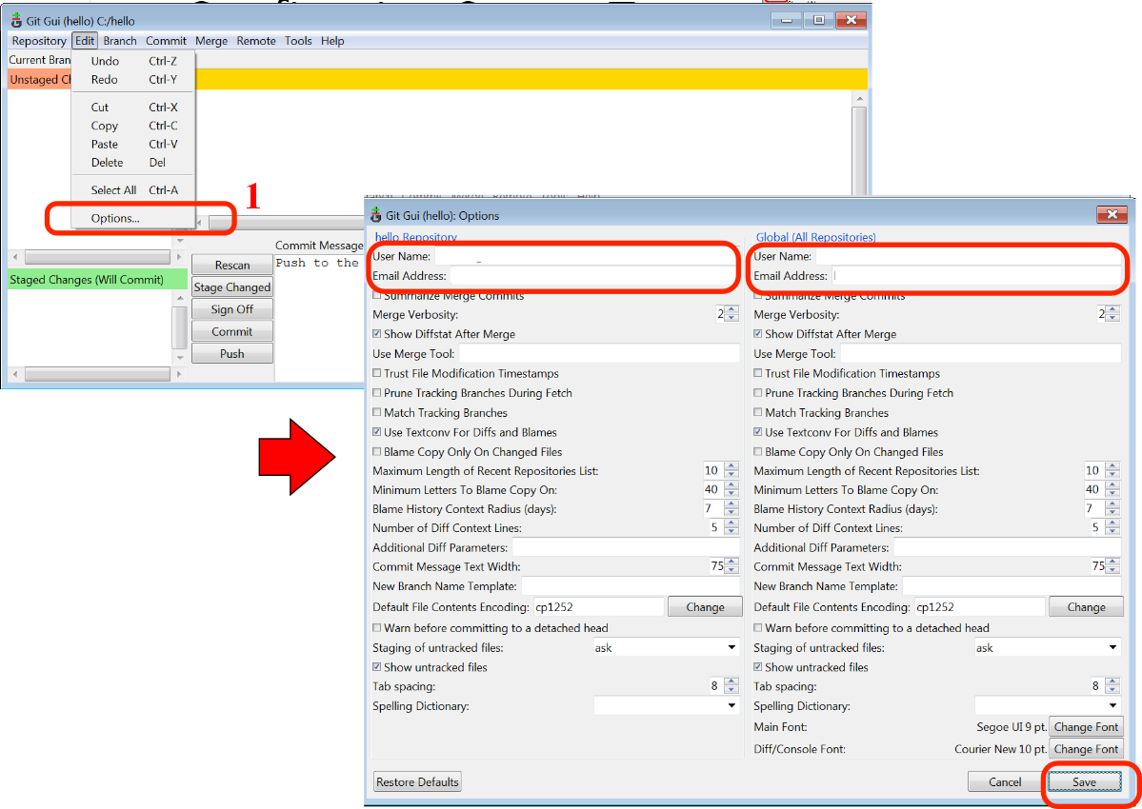
Configuring Git GUI
Git Login/Username

Slide 26
Start Using Repository
Adding Files
1. Add an image file to the folder
2. Add a text file to the folder

Slide 27
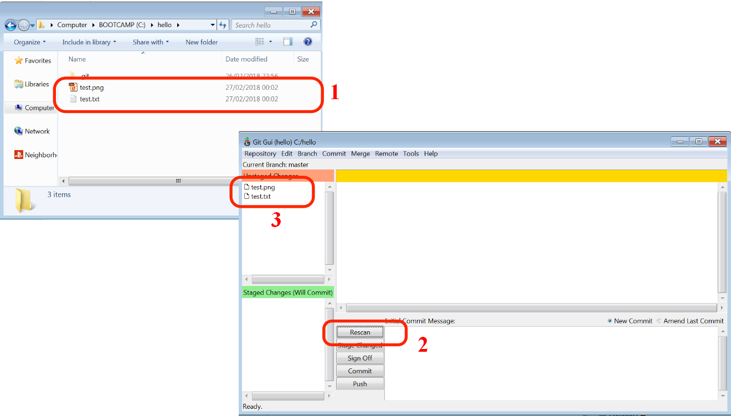
Scan
Git GUI will show non-versioned files in the folder after ‘rescanning’

Slide 28
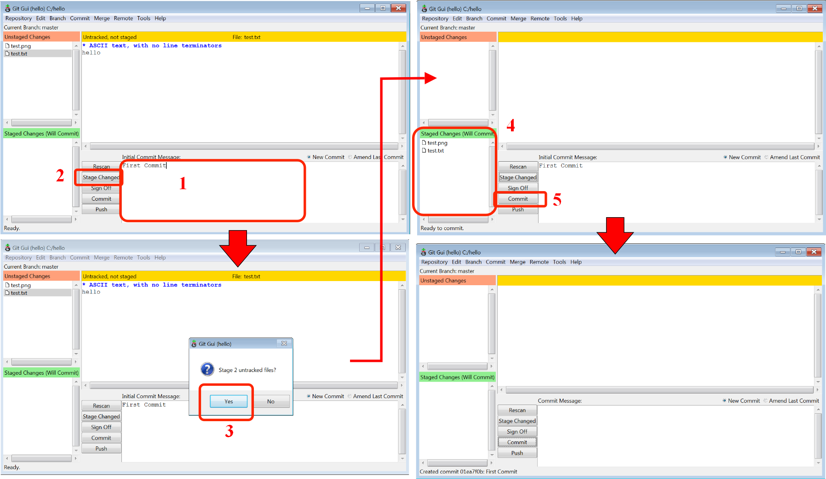

Slide 29
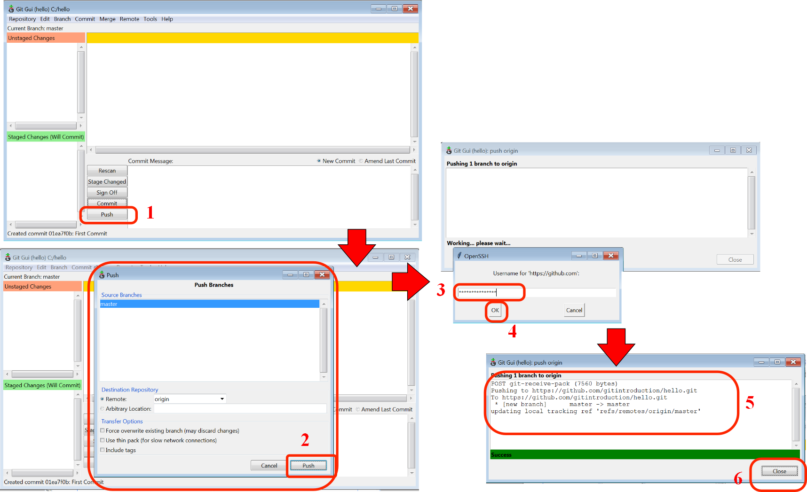
Push onto GitHub

Slide 30
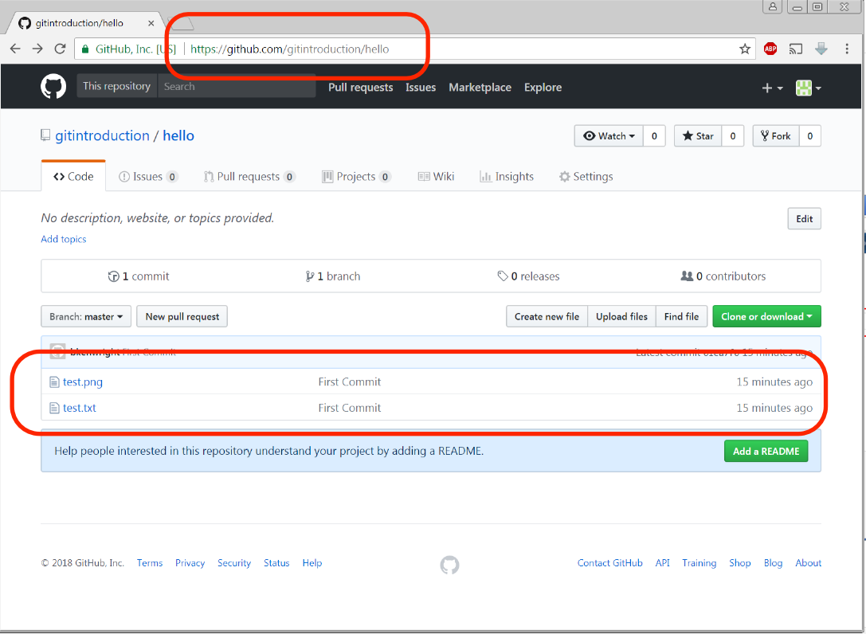
Did It Work?
Check website
Changes have been saved to the main repository

Slide 31
Review
Created Repository on GitHub
Cloned Repository Locally (using GitHub URL)
Local Folder/Repository Connection
Adding Files & Commited them to GitHub Repository
Remember `Local Commit’ and `Pushing

Slide 32
Start Using The Repository
Add additional files
Change content of current files (e.g., add more text to the .txt file) and rescan/commit/push changes

Slide 33
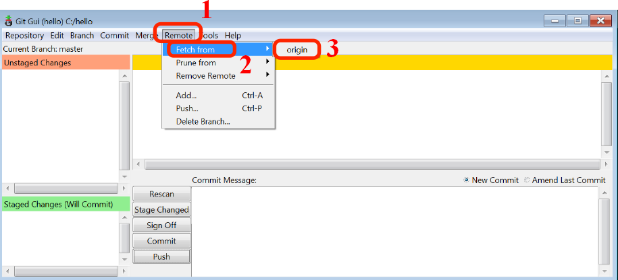
Pull
Grabbing changes & keeping up to date

Slide 34
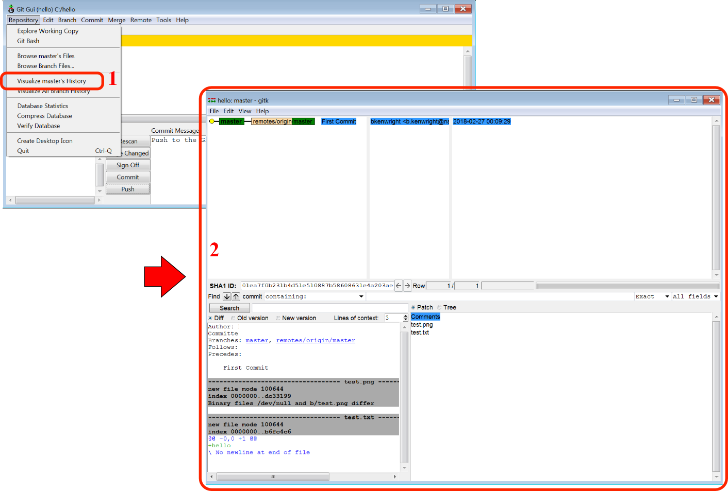
History/Stats
What changed…
When changed…
Who changed what…

Slide 35
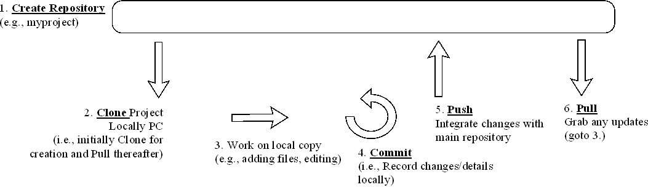
Review Events Overview
Create/Clone/Commit/Push/Pull

Slide 36
Practical Tips
Ignoring dlls/objs/thumbs
By default git will ignore specific file types
Fix by adding ‘gitignore_global.txt’:
# H://gitignore_global.txt
#ignore thumbnails created by windows
Thumbs.db
#Ignore files build by Visual Studio
*.obj
*.pdb
*.user
*.aps
*.pch
*.vspscc

Slide 37
Summary
Track changes over time
Secure & Safe
Report bugs/progress

Slide 38
Cool Projects on Github
Node.js
jQuery
the Linux Kernel
Ruby on Rails
and many many more...

Slide 39
Remember (ToDos)
Create a repository
Regularly check-in updates (e.g., weekly)
Get into the habit
Use clear comments/details for each commit
Enable issue tracking in GitHub for project group work

Slide 40

No Substitute for Coordination

Slide 41
Exercise
Create a new directory (folder)
Add a new file called ‘gitExercise.txt’
Write 3 git commands
Save this file
Move the file to the staging area
Commit this file
Push the file onto your GitHub repository

Slide 42
Exercise
Add a new file called ‘test.jpg’
(find any .jpg file and rename it to test.jpg’
Commit it to the repository
Remove it from the depository
(i.e., delete the file and stage/commit the changes)
Push the file onto your GitHub repository
After you’ve checked online (website) that the file has been deleted
Recover the file
(revert the changes to the previous revision and recover the deleted file locally)

Slide 43
Exercise
Form a team of 2
On separate computers create/clone a repository
Collaboratively add/edit multiple files

Slide 44
Exercise
Clone the Repository from GitHub for a simple open source 2D C++ OpenGL game
https://github.com/ADFLin/QuadAssault
Compile and run the game
Create a new repository and upload your game to your repository

Slide 45
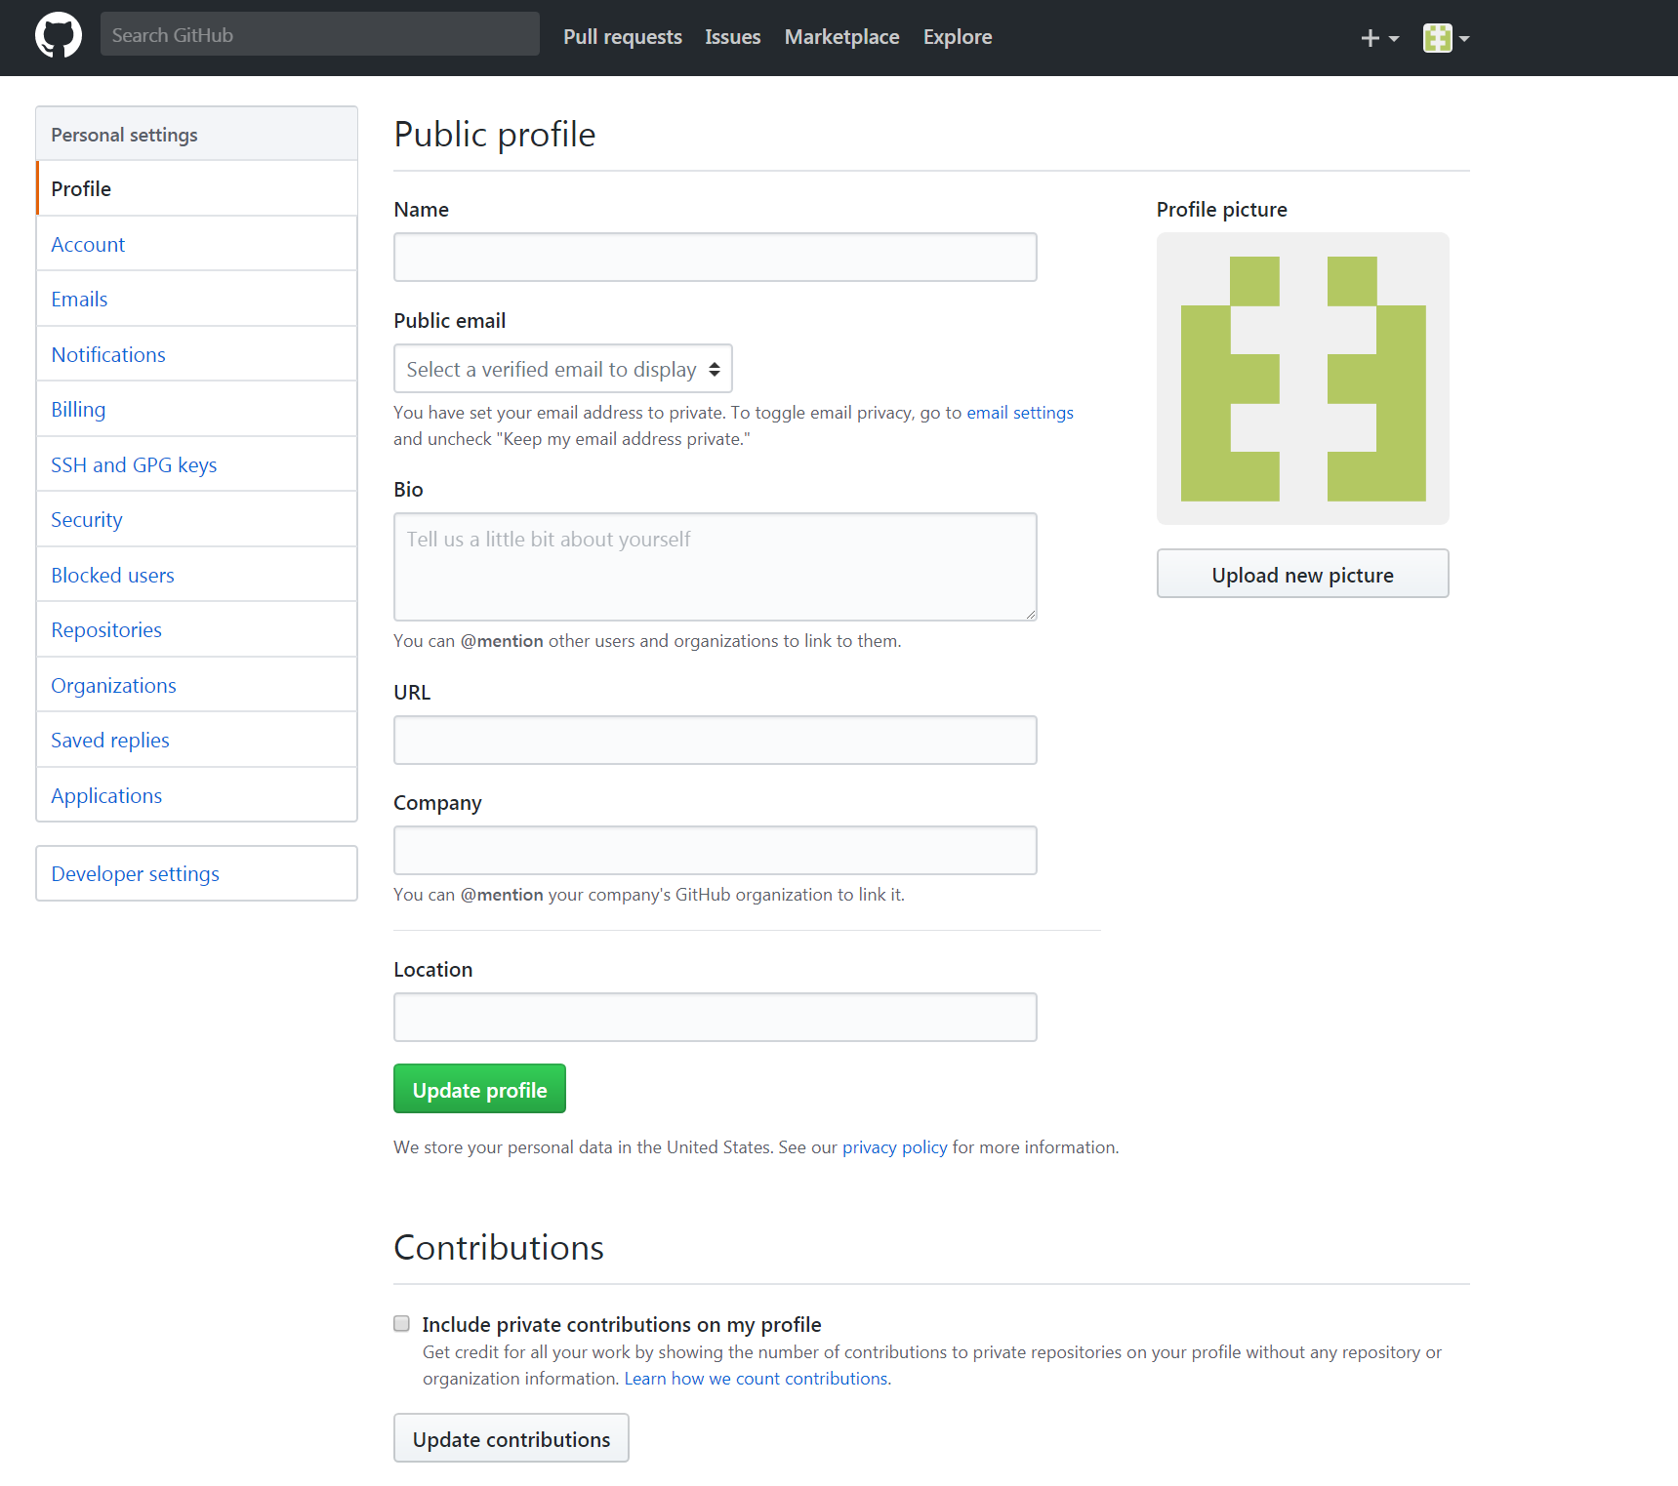
Exercise
Customize your GitHub profile
Picture
Description/Interests

Slide 46
Practical
Register with GitHub (i.e., if not already registered)
Create a repository to manage practical work
Show supervisor/module leader
Explore features/options within version control

Slide 47
Reference
Learn Git Fast Tutorials
https://mindweb.network/board/learn-git-fast
Try Git Tutorial (Type in Commands)
https://try.github.io
GitHub Guides
https://guides.github.com/
Git – The Simple Guide
http://rogerdudler.github.io/git-guide/
Git on Windows for Newbs
https://code.tutsplus.com/tutorials/git-on-windows-for-newbs--net-25847

Slide 48
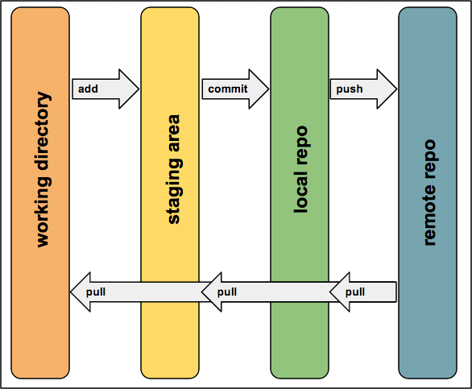
Questions/Discussion

